Slide 1


NEXT GEN EMPLOYABILITY PROGRAM
CREATING A FUTURE-READY WORKFORCE
Student Name :
BODA BHUVANESHWARI
College Name :
Student ID :
STU67347b269eb4b1731492646
TEEGALA KRISHNA REDDY ENGINEERING COLLEGE

Slide 2
CAPSTONE PROJECT SHOWCASE
Project Title
DIGITALPAYMENT WALLET
Abstract | Problem Statement | Project Overview | Proposed Solution | Technology Used | Modelling & Results | Conclusion | Q&A

Slide 3
Abstract
1
The Digital Payment Wallet is a mobile application designed to simplify financial transactions by offering features like peer-to-peer transfers, bill payments, mobile recharges, and e-commerce purchases in one platform.
2
Built using the MERN stack (MongoDB, Express.js, React, Node.js), the application ensures fast performance, scalability, and real-time updates.
3
The wallet incorporates strong security features such as two-factor authentication (2FA), encryption, and biometric login to protect user data and prevent unauthorized access.
4
The app is designed to be accessible in low-bandwidth areas and supports multiple languages, fostering financial inclusion for users without traditional banking access.

Slide 4


Problem Statement
In the modern world, traditional payment methods like cash and card transactions often face several challenges including security risks, inconvenience, and inefficiency. Consumers and businesses alike require a more seamless, secure, and convenient way to handle payments and manage financial transactions . Despite the increasing shift toward digital payments, many individuals, especially in developing regions, still face barriers to using digital payment systems, such as limited access to banking infrastructure, poor internet connectivity, and a lack of trust in digital platforms.
The problem is compounded by the growing concerns around security breaches, fraud, and unauthorized access to sensitive financial data in existing digital wallets. Additionally, while several payment platforms exist, there is a gap in integrating various services (e.g., peer-to-peer payments, bill payments, e-commerce transactions, etc.) into a single, user-friendly wallet application.

Slide 5

Project Overview
The Digital Payment Wallet project aims to create a comprehensive, secure, and user-friendly mobile application that allows users to perform a wide variety of financial transactions directly from their smartphones. The platform will serve as a one-stop solution for users to manage their payments, transfers, and financial activities without the need for traditional banking methods. This solution will address challenges related to security, accessibility, convenience, and integration of services..
The goal of this project is to build a secure, integrated, and reliable digital wallet that not only allows users to make simple payments but also supports a wide range of services, such as peer-to-peer transfers, bill payments, mobile top-ups, and e-commerce transactions, all in one platform.

Slide 6
Proposed Solution
The Digital Payment Wallet project proposes the development of an integrated, secure, and user-friendly mobile application designed to provide users with a seamless and efficient way to manage their financial transactions. The solution will address current issues faced by users and businesses when using traditional or existing digital payment methods. By creating a single platform that can handle multiple types of transactions, from peer-to-peer payments to bill payments and e-commerce, the proposed digital wallet will enhance convenience, security, and accessibility for its users.

Slide 7
Technology used
The proposed Digital Payment Wallet will leverage the MERN stack (MongoDB, Express.js, React, Node.js) to develop the backend and frontend components. This stack is ideal for building fast, scalable, and highly interactive web applications, making it a great choice for the development of a modern digital payment platform.
MongoDB will be used as the database to store and manage the user data, transactions, wallet balances, payment history, and other dynamic data associated with the wallet.
Express.js will serve as the backend framework to handle HTTP requests, define APIs, and manage routing. It will act as a middleware layer between the frontend and the database.
React will be used for building the user interface (UI) of the digital wallet, ensuring a dynamic, interactive, and responsive experience.
Node.js will be used for running JavaScript code on the server-side handling backend logic, and managing the communication between the frontend(React) and the database (MongoDB)

Slide 8
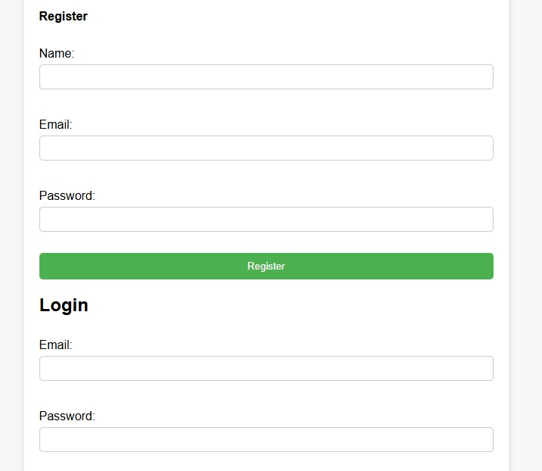
Modelling & Result
FRONTEND
Digital Payment Wallet

Slide 9
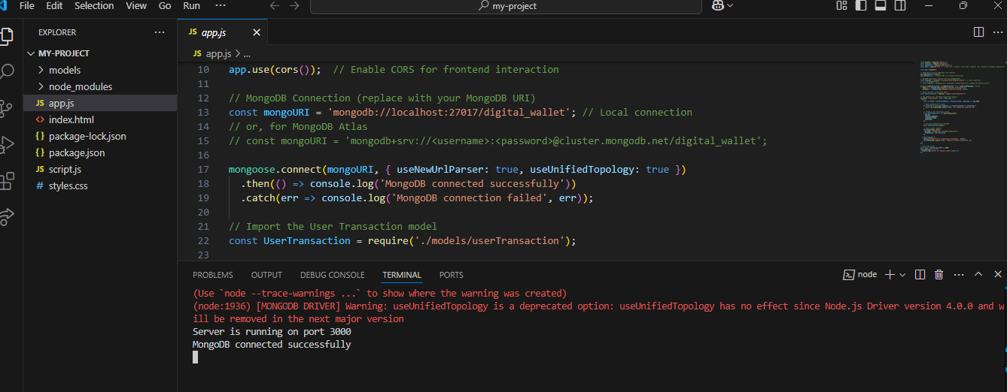
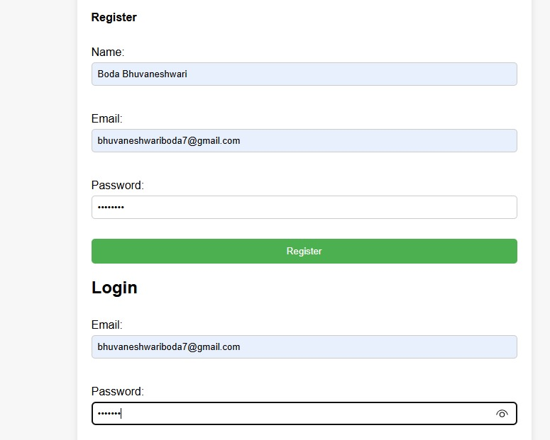
Modelling & Result
MongoDB connection
TRANSACTION RECORDED SUCCESSFULLY

Slide 10
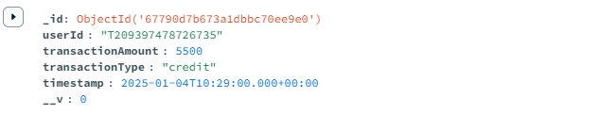
Modelling & Result
MongooDB update..

Slide 11
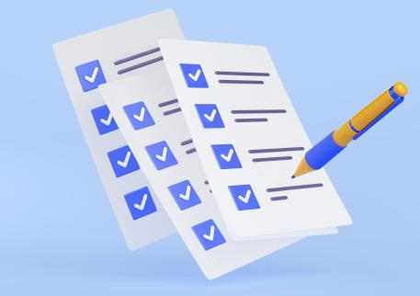
Conclusion
By utilizing the MERN stack, the Digital Payment Wallet project will ensure a fast, scalable, and secure platform that delivers a seamless experience for users. The stack's combination of MongoDB, Express.js, React, and Node.js provides a powerful foundation for building a modern digital wallet that can handle a high volume of real-time transactions while maintaining data integrity and security. This technology stack is highly suitable for building a responsive, user-friendly, and secure digital payment platform.

Slide 12


Notes:
Thank You !!

